Slide 1

Introduction
https://github.com/feraco/R-workshop
Frederick Feraco
Science Research & Computer Science Teacher
fferaco@shufsd.org

Slide 2
What is ?
free
software environment
for statistical computing
and graphics
Notes:
R refers to both the language and the environment/application

Slide 3

What is ?
A software program that makes working in R easier
IDE: Integrated Development Environment

Slide 4
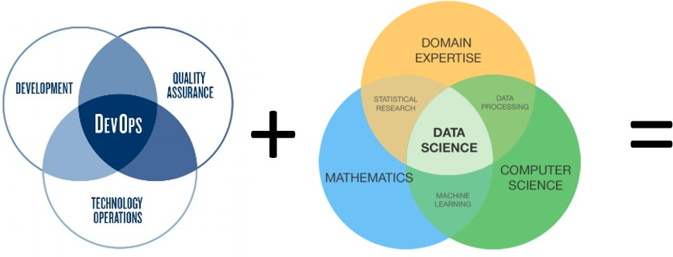
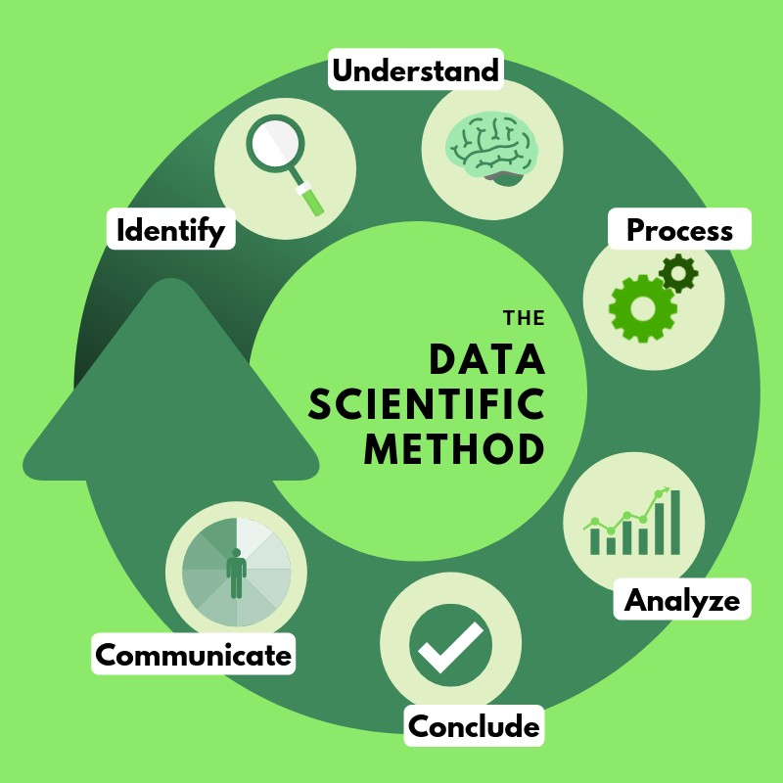
Lesson #1 – ‘Ontology’ of Data Science (the boarder scope..)
[ source: https://towardsdatascience.com ]
[ Keywords: formal ontology; hermeneutic cycle; epistemology; knowledge/ data/ information re-cycling ]

Slide 5


A robust , powerful and compact purpose-built tool for statistical computing and data visualisation that is self-containing/ standalone and optimised for vector operations.
[ Source: https://www.datasciencecentral.com/ profiles/blogs/data-science- summarized-in-one-picture

Slide 6






Lesson #1 – Why R …?
A complex decision: guarantee, reliability, standardisation, price, flexibility,
…etc. considerations
R is integral part of the Data Science workflow
Raw data collection, preparation and formatting (e.g. Spreadsheets)
Data cleansing and management (e.g. OpenRefine)
Data analysis, visualization and publishing (e.g. R, Python, SQL)

Slide 7

Lesson #1 – Why R …?

Slide 8
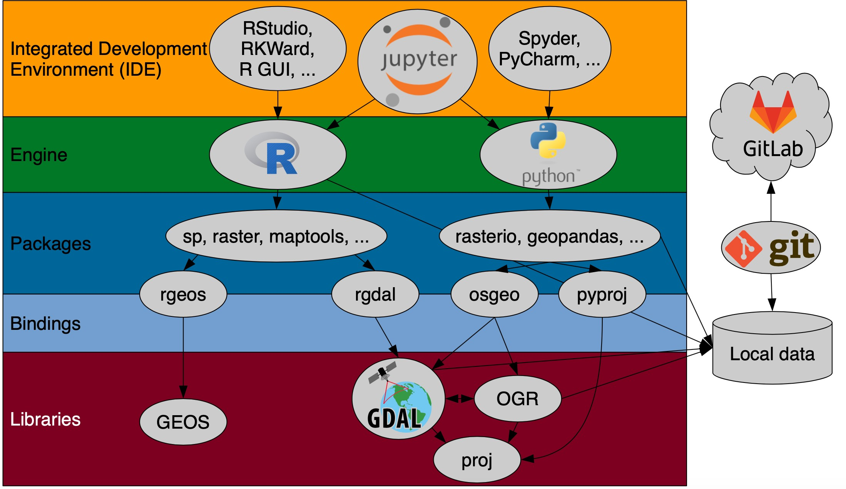
Lesson #1 – Systemic overview [ an illustrative example ]

Slide 9
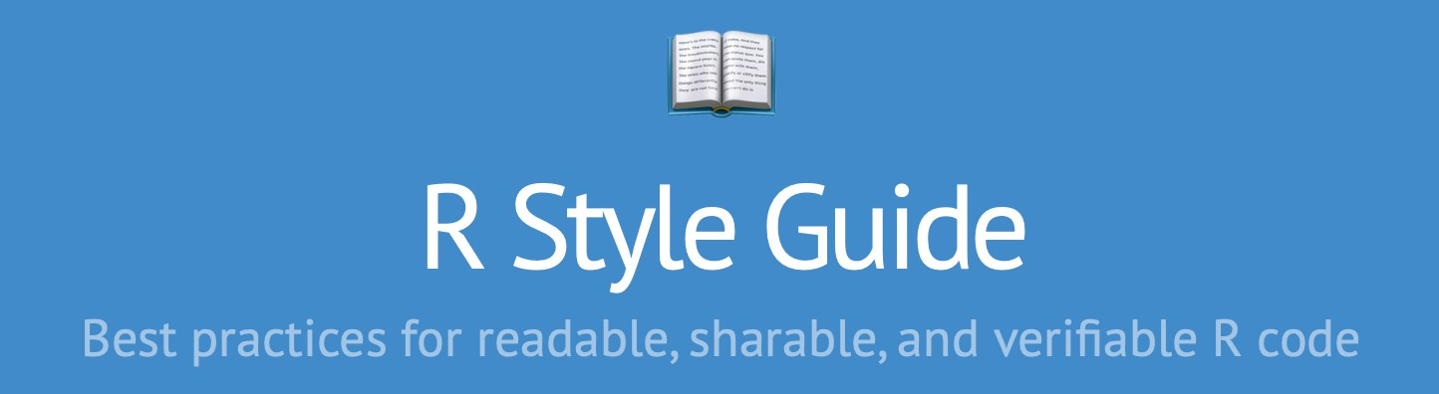
Lesson #1 – The R syntax.. (‘The grammar of a programming language’)
“R is a high-level programming language used primarily for statistical computing and graphics. R does not have any well defined coding recommendations or de facto standards. This style guide provides some recommendations based on personal experience and expert opinions.”
Web: http://jef.works/R-style-guide/

Slide 10
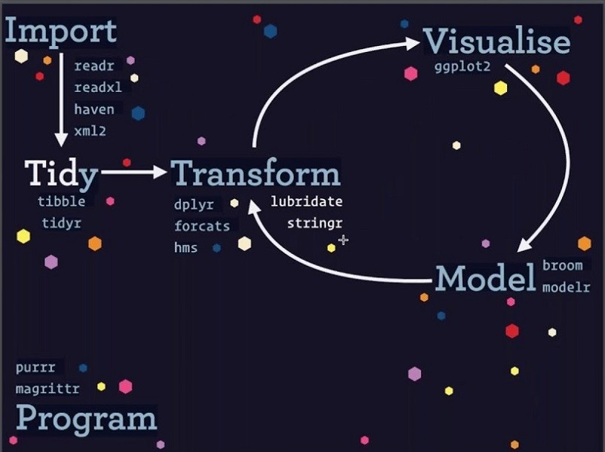
Lesson #1 – Tidyverse ecosystem overview & core R packages..
Core packages we are going to use..
library(gridExtra) # ggplot
library(hexbin) # ggplot library(dbplyr) # R and databases library(RSQLite) # R and databases library(tidyverse) # lesson 3 onwards library(lubridate)
library(readr) library(ggplot2) library(dplyr) library(magrittr) library(tidyr)

Slide 11
Lesson #1 – Working with data - fundamental concepts / elements..
Introductory statistical package ‘mosaic’ overview > https://github.com/mlaviolet/Mosaic- cheatsheets/raw/master/mosaic-cheatsheet-gf.pdf
Base-R instructions > http://github.com/rstudio/cheatsheets/raw/master/base-r.pdf
ggplot data visualisation > https://github.com/rstudio/cheatsheets/raw/master/data-visualization-2.1.pdf factors with ‘forcats’ > https://github.com/rstudio/cheatsheets/raw/master/factors.pdf
Dates and times > https://github.com/rstudio/cheatsheets/raw/master/lubridate.pdf Working with strings > https://github.com/rstudio/cheatsheets/raw/master/strings.pdf
Data/ file import > https://github.com/rstudio/cheatsheets/raw/master/data-import.pdf
Data transformation with ‘dplyr’ > https://github.com/rstudio/cheatsheets/raw/master/data-transformation.pdf

Slide 12
Lesson #1 – Why learning R …?
R does not involve lots of pointing and clicking, and that’s a good thing
R code is great for reproducibility
R is interdisciplinary and extensible
R works on data of all shapes and sizes
Advanced in handling missing values , date objects, etc.
R produces high-quality graphics
R has a large and welcoming community
Not only is R free, but it is also open-source and cross-platform

Slide 13
What is Radiant R app?
A Web app software program that makes working in R easier
https://vnijs.shinyapps.io/radiant/?SSUID=da20c33bd3

Slide 14
What is Kaggle.com and R Kernal?
A Data science site for learning dta science in r and python.
You can run your code through the website.
https://www.kaggle.com/

Slide 15
Make a free account
go to https://login.rstudio.cloud/ and make a free account.
Go to https://www.kaggle.com/ and make a free account.
Open this link after you have made a free account at Kaggle.
https://www.kaggle.com/code/feraco/r-workshop

Slide 16
R Studio analysis tutorial
https://datacarpentry.org/R-ecology-lesson/index.html

Slide 17
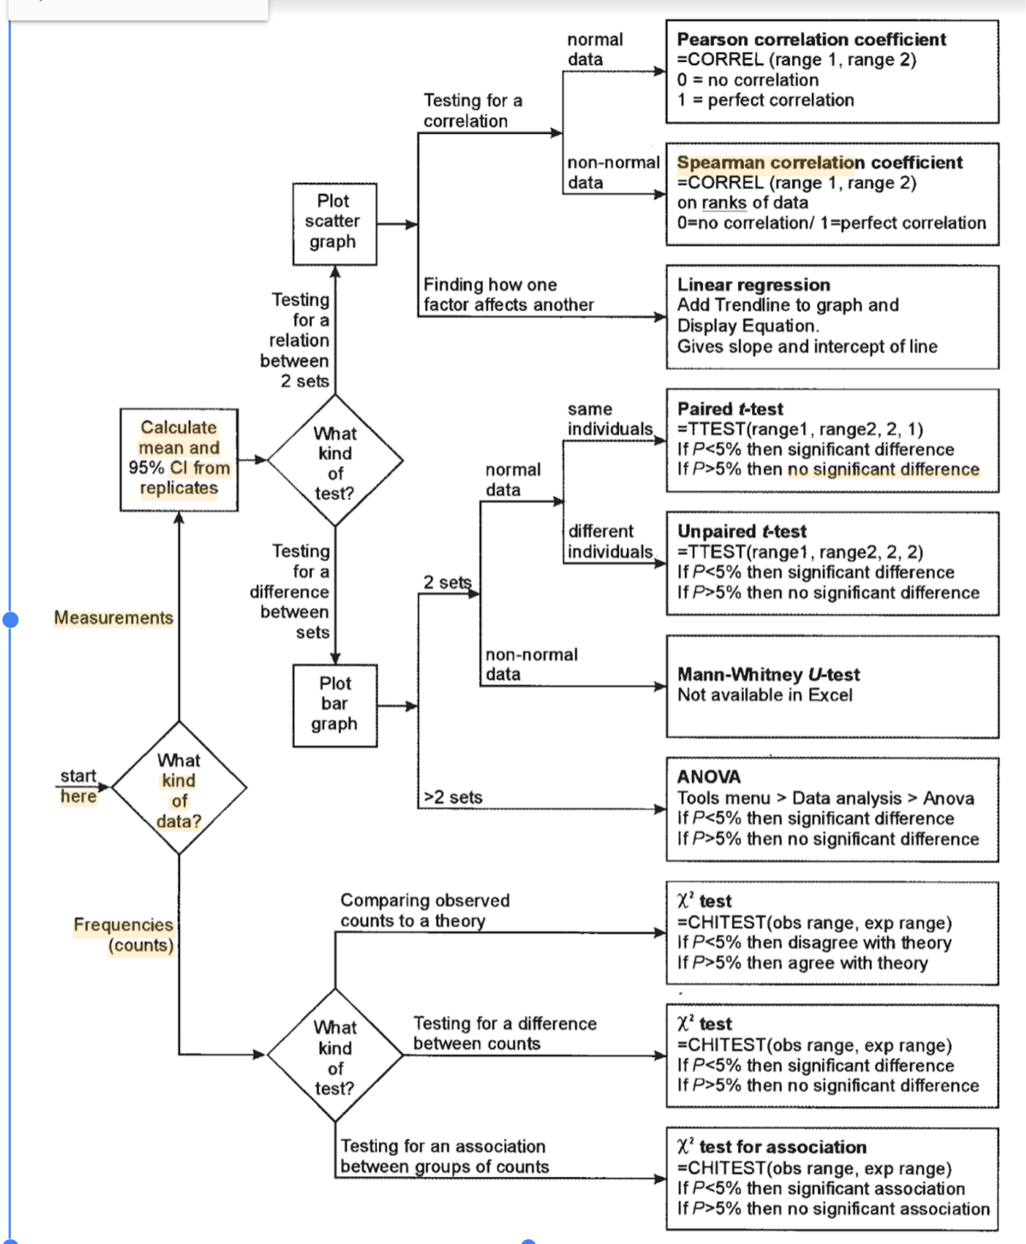
Dta analysis Flow Chart
https://sites.google.com/shufsd.org/feracoscienceresearch/stats-1

Slide 18
Useful URLs
Lessons
https://edcarp.github.io/2020-06-16-sfc-online/ https://datacarpentry.org/R-ecology-lesson/#chapters
Download the datasets
https://ndownloader.figshare.com/articles/1314459/versions/9 https://ndownloader.figshare.com/files/2292169
R scripts & handout
https://github.com/robertn01/Data-Carpentry-R-RStudio-introduction https://datacarpentry.org/R-ecology-lesson/code-handout.R https://github.com/justinchuntingho/Data-Carpentry-Ecology-R

Slide 19
Lesson #1 – ‘Before we start…’
https://datacarpentry.org/R-ecology-lesson/00-before-we-start.html
Learning Objectives
Describe the purpose of the RStudio Script, Console, Environment, and Plots panes
Organize files and directories for a set of analyses as an R Project, and understand the purpose of the working directory
Use the built-in RStudio help interface to search for more information on R functions
Demonstrate how to provide sufficient information for troubleshooting with the R user community

Slide 20
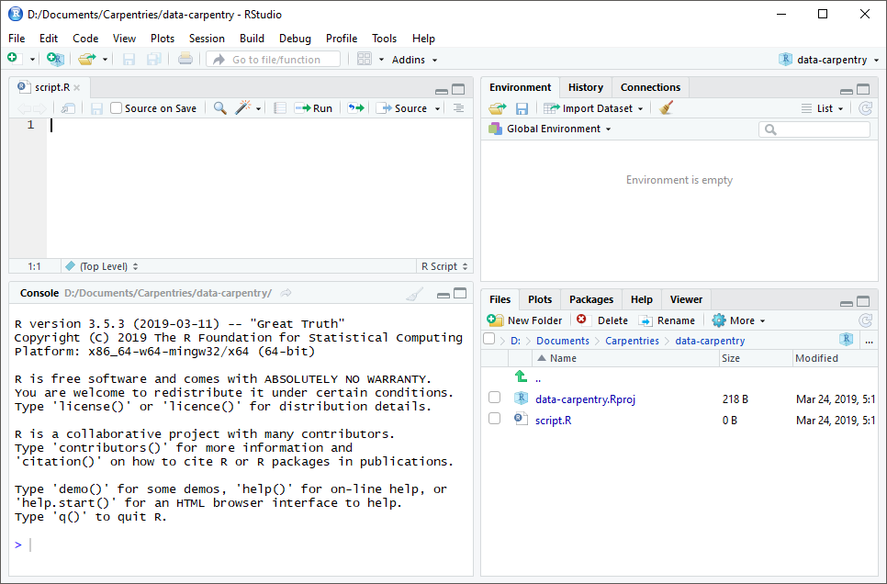
Lesson #1 – The RStudio Script, Console, Environment, and Plots panes
RStudio is divided into four “panes”. The placement of these panes and their content can be customized (see menu, Tools -> Global Options -> Pane Layout).
The Default Layout is:
(1) Top Left - Source: your scripts and documents
(2) Bottom Left - Console: what R would look and be like without RStudio
(3) Top Right - Environment/ History: look here to see what you have done
(4) Bottom Right - Files, plots, packages, documentation/ help, etc.
(1)
(3)
(2) (4)
RStudio’s default GUI arrangement on Windows 10.

Slide 21
Lesson #1 – Interacting with R/Studio
We call the instructions commands and we tell the computer to follow the instructions by executing (also called running) those commands.
Two main ways of interacting with R:
(1) by using the Console
Commands can be directly typed and instantly executed (by pressing Enter)
Also, results will be shown for executed commands
Commands executed earlier on are preserved and can be recalled by pressing the Up/ Down arrow buttons
(2) by using script files (plain text files that contain your code). [reproducibility considerations]
Because we want our code and workflow to be reproducible, it is better to type the commands we want in the script editor (Source pane), and save the script. This way, there is a complete record of what we did, and anyone (including our future selves!) can easily replicate the results on their computer.
RStudio allows us to execute commands directly from the script editor by pressing Ctrl (Cmd) + Enter key combination

Slide 22
Lesson #1 – Interacting with R/Studio (cont’d..)
RStudio provides the Ctrl + 1 and Ctrl + 2 shortcuts allow you to jump between the Script and the Console
panes
If R is ready to accept commands, the R console shows a > prompt
If R is still waiting for you to enter more data because it’s incomplete yet, the console will show a ’+’ prompt.
It means that you haven’t finished entering a complete command. When this happens, and you thought you finished typing your command, click inside the console window and press Esc; this will cancel the incomplete command and return you to the > prompt.

Slide 23

Lesson #1 – Setting up our working environment (working directory)
Working directory [computing concept] - The directory in which you are currently working. Path names that do not start with the root directory are assumed by the operating system to start from the working directory. It is the place where R will look for and save files. When you write code for your project, your scripts should refer to files in relation to the root of your working directory and only to files within this structure.
Set and organizing your working directory
data/ raw_data. Use this folder to store your raw data and intermediate datasets. For the sake of transparency and provenance, you should always keep a copy of your raw data accessible and do as much of your data cleanup and pre-processing programmatically (i.e., with scripts, rather than manually) as possible.
data_output/ When you need to modify your raw data, it might be useful to
store the modified versions of the datasets in a different folder.
Raw_data
Scripts
documents/ Used for outlines, drafts, and other text.
fig_output/ This folder can store the graphics that are generated by your scripts.
Data_output
scripts/ A place to keep your R scripts for different analyses or plotting.

Slide 24
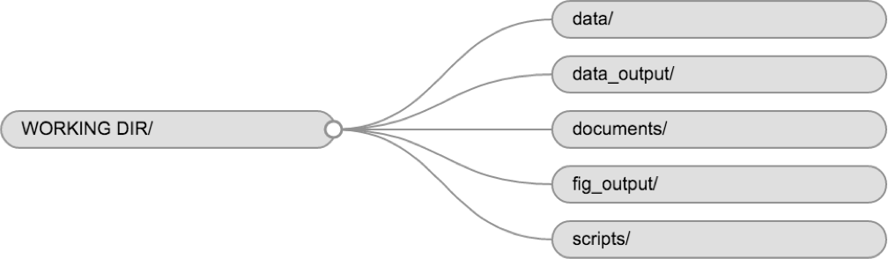
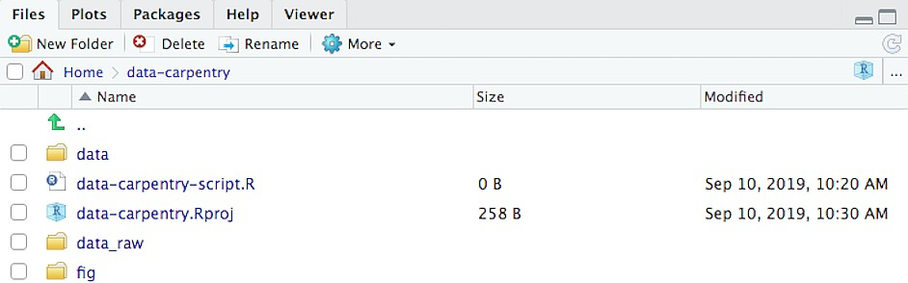
Lesson #1 – Setting up our working environment (working directory tree concept)
Set and organizing your working directory (cont’d…)
Creating the directory tree
Step #1: create/ set your working directory by creating your ‘New Project’
Step #2. Add subdirectories either:
Through R commands
Via RStudio GUI
Directory tree structure abstraction that is consists of the working directory and subdirectories in a hierarchical arrangement.

Slide 25
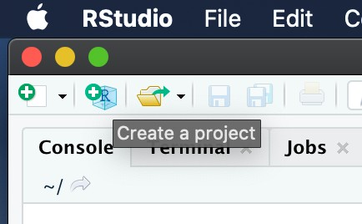
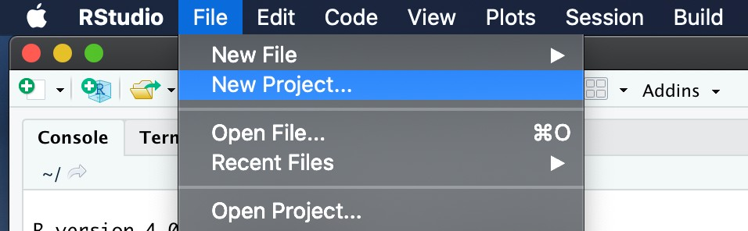
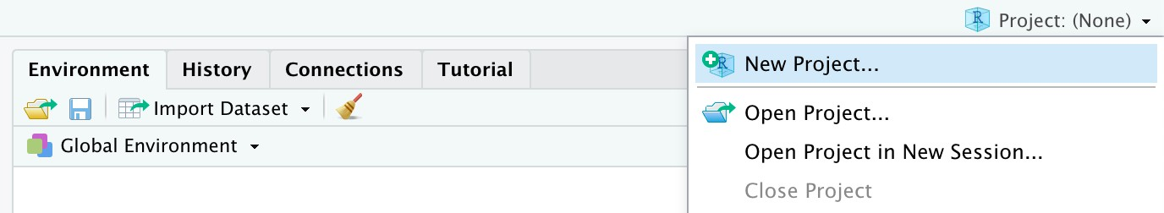
Lesson #1 – Setting up our working environment ( Step #1: Create a New Project )
Using RStudio projects makes this easy and ensures that your working directory is set up properly.
Under the File menu, click on New Project. Choose New Directory, then New Project.
Enter a name for this new folder (or “directory”), and choose a convenient location for it. This will be your working directory for the rest of the day (e.g., ~/data-carpentry).
Click on Create Project.
4. Download the code handout, place it in your working directory and rename it (e.g., data- carpentry-script.R). OR Create a new R script file.
5.
(Optional) Set Preferences to ‘Never’ save workspace in RStudio.
[ * Code handout download URL: https://datacarpentry.org/R-ecology-lesson/code-handout.R ]

Slide 26
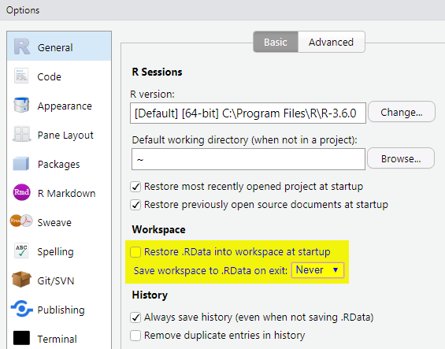
Lesson #1 – Setting up our working environment ( Step #1: Set up your workspace)
Using RStudio projects makes this easy and ensures that your working directory is set up properly.
(Optional) Set Preferences to ‘Never’ save workspace in RStudio.
A workspace is your current working environment in RStudio which includes any user-defined object.
By default, all of these objects will be saved, and automatically loaded, when you reopen your project.
Saving a workspace to .RData can be cumbersome, especially if you are working with larger datasets, and it can lead to hard to debug errors by having objects in memory you forgot you had.
To turn this off, go to Tools –> ‘Global Options’ and
select the ‘Never’ option for ‘Save workspace to
.RData’ on exit.’

Slide 27
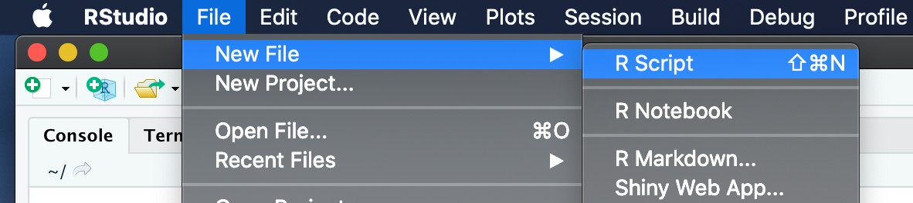
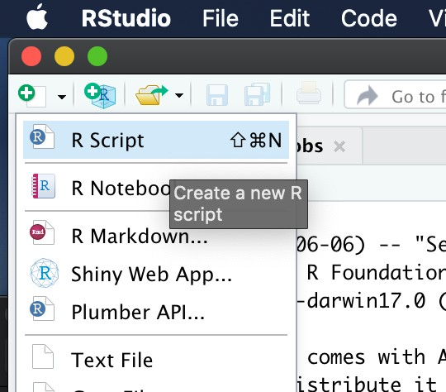
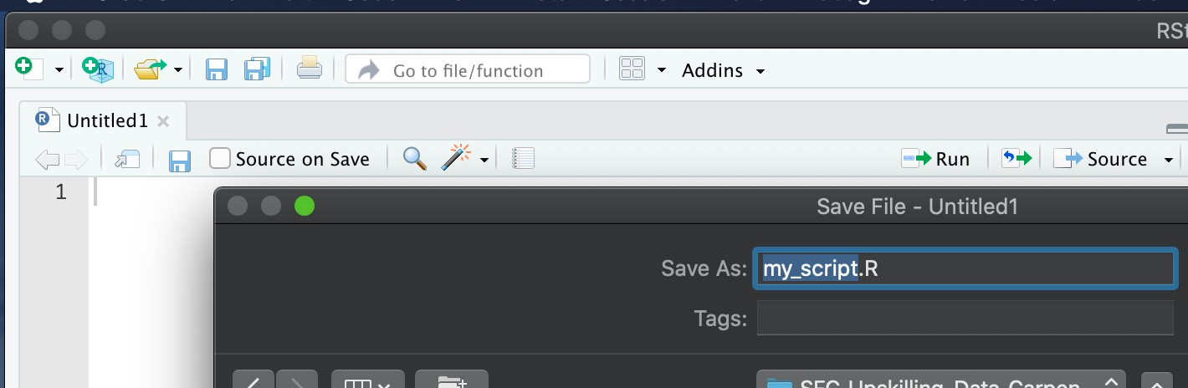
Lesson #1 – Setting up our working environment ( Step #1: Create your R script file)
Create a new file where we will type our scripts
There are multiple ways around.. ☺
Go to File > New File > R script. Click the save icon on your toolbar and save your script as “script.R”.

Slide 28
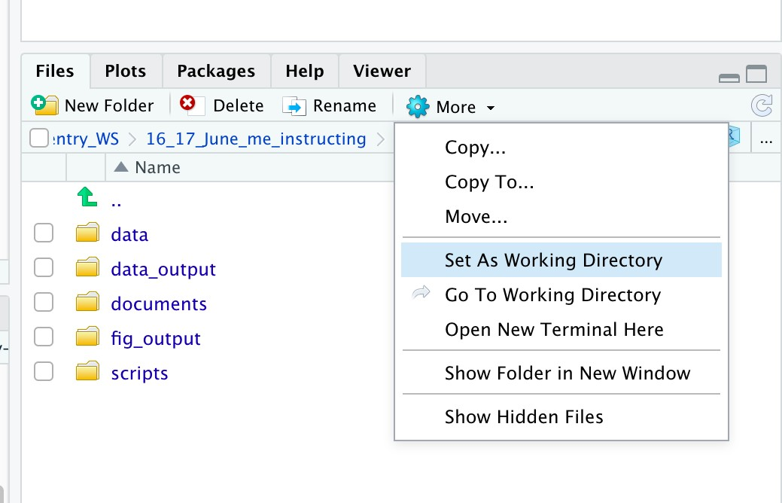
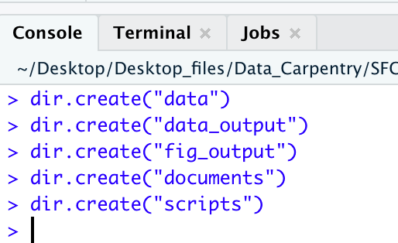
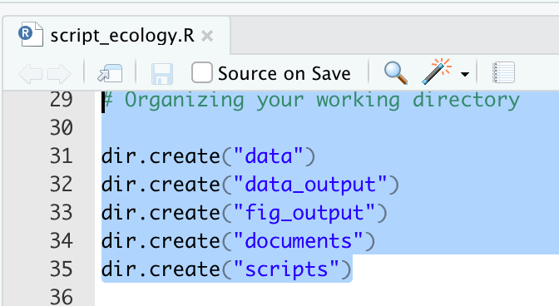
Lesson #1 – Setting up our working environment (directory tree)
Set and organizing your directory tree
Under the Files tab on the right of the screen, click on New Folder and create a folder named data_raw within your newly created working directory (e.g., ~/data-carpentry/)…
OR alternatively can type R commands in the Console or execute an R script (Source pane) – e.g.:
If your working directory is not what it should be, you can change it by navigating in the file browser to where your working directory should be, clicking on the blue gear icon “More”, and selecting “Set As Working Directory”.
Alternatively,
use setwd("/path/to/working/directory") to reset your working directory. However, your scripts should not include this line, because it will fail on
someone else’s computer (!).
Hit Enter when wishing to execute commands on the Console (Left). And Ctrl (Cmd) +
Enter will execute specific lines or highlighted code snippets in an R script (Right).

Slide 29
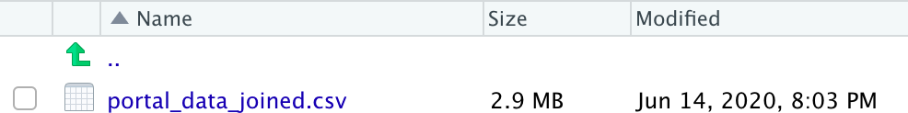
Lesson #1 – Downloading the data directly into your data (or raw_data) folder
The direct download link is: https://ndownloader.figshare.com/files/2292169.
Place this downloaded file in the data/ (OR raw_data) folder you just created.
You can do this directly from R either from R script or as a Console command

Slide 30
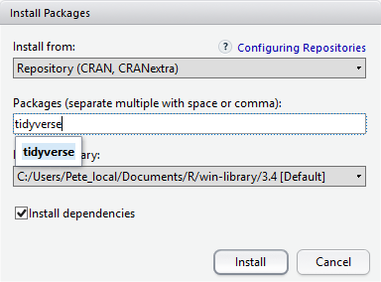
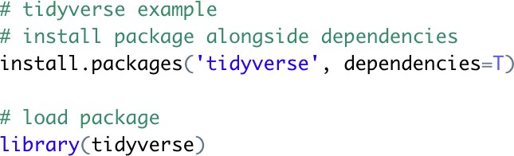
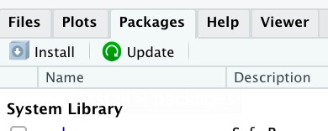
Lesson #1 – Installing and loading additional R packages – many ways around!
Loads of R packages have been made available in central repositories, like the one hosted at CRAN, for anyone to download and install into their own R environment. Two main ways of installing and loading further packages.
1. Additional packages can be installed from the ‘packages’ tab (RStudio GUI – Pane ‘4’) 🡪 Install OR Tools 🡪 Install Packages…
2. Packages can be installed and loaded into RStudio by Console command OR R script
– syntax: install.packages(‘package_name’)
Alternatively:
NB: Because the install process accesses the CRAN repository, you will need an Internet connection to install packages.
At the bottom of the Install Packages window is a check box to ‘Install dependencies’

Slide 31
Lesson #1 – Installing and loading additional R packages – Finger practice
Select an arbitrary R package from CRAN* Use the install option from the packages tab or use install.packages() and library() functions on the Console or Source (R script) panes to install and load another package into RStudio.
* https://cran.r-project.org/web/packages/available_packages_by_name.html
List of core packages for the workshop: https://github.com/datacarpentry/R-ecology- lesson/blob/master/needed_packages.R

Slide 32
Lesson #1 – Troubleshooting: Installing R packages (optional)
Sometimes a package will not install, try a different CRAN mirror
Tools > Global Options > Packages > CRAN Mirror
Alternatively you can go to CRAN and download the package and install from ZIP file
Tools > Install Packages > set to ‘from Zip/TAR’
It is important that R, and the R packages be installed locally, not on a network drive.

Slide 33
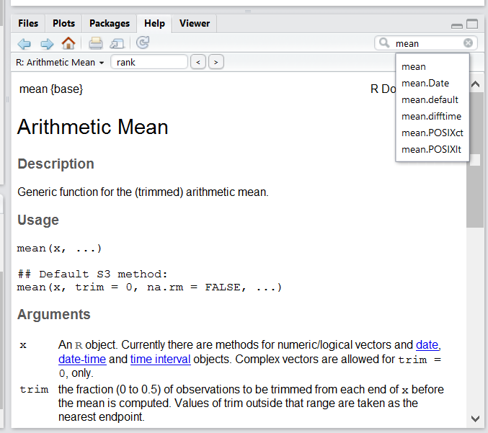

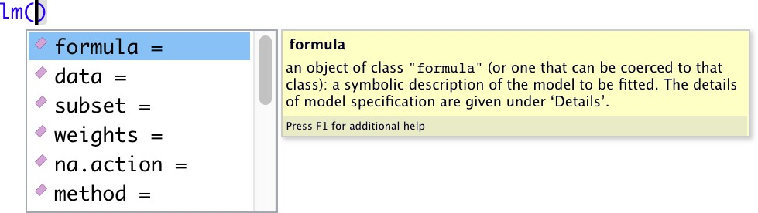

Lesson #1 – Looking for help? RStudio’s built-in options..
I know the name of the function I want to use, but I’m not sure how to use it
If you just need to remind yourself of the names of the arguments, you can use
I want to use a function that does X, there must be a function for it but I don’t know which one…
I am stuck… I get an error message that I don’t understand
Google on the error message + ‘r’
+1: If know the object’s name but not sure what R package should be installed and loaded…

Slide 34
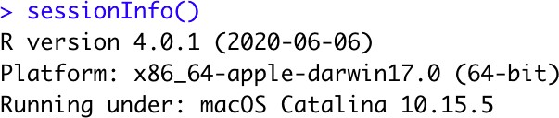
Lesson #1 – Looking for help? RStudio’s built-in options..
To share an object with someone else, if it’s relatively small, you can use the function dput(). It will output R code that can be used to recreate the exact same object as the one in memory..
If the object is larger, provide the raw file (i.e., your CSV file) with your script up to the point of the error. Alternatively, in particular if your question is not related to a data frame, you can save any R object to a file. It can be sent to someone by email who can read it with the readRDS().
always include the output of sessionInfo() function as it provides critical information about your platform, the versions of R and the packages that you are using, etc.

Slide 35




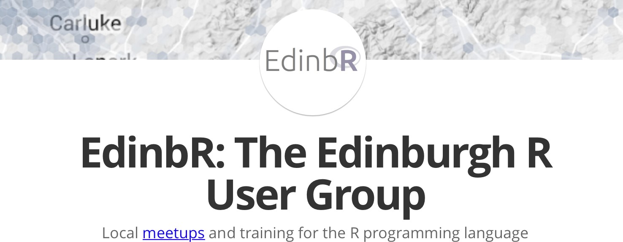
Lesson #1 – Looking for help? Reach out Communities & User Forums
https://community.rstudio.com
https://support.rstudio.com/hc/en-us/articles/201141096-
Getting-Started-with-R
https://www.rdocumentation.org
https://stackoverflow.com
http://edinbr.org
… etc

Slide 36
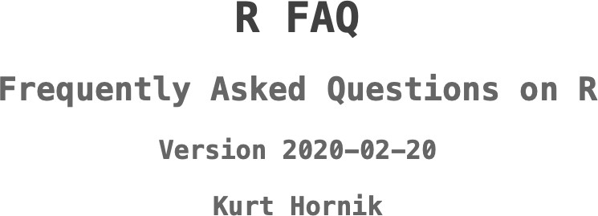
Lesson #1 – Looking for help? More resources..
The R-help mailing list: it is read by a lot of people (including most of the R core team)
The Posting Guide for the R mailing lists.
How to ask for R help useful guidelines
This blog post by Jon Skeet has quite comprehensive advice on how to ask programming questions.
The reprex package is very helpful to create reproducible examples when asking for help. The [rOpenSci community call “How to ask questions so they get answered”], rOpenSci Blog and video recording includes a presentation of the reprex package and of its philosophy.
https://cran.r-project.org/doc/FAQ/R-FAQ.html
… etc

Slide 37
How to write a reproducible example
A reproducible example allows someone else to recreate your problem by just copying and pasting R code.
There are four things you need to include to make your example reproducible: required packages, data, code, and a description of your R environment.
Packages should be loaded at the top of the script, so it’s easy to see which ones the example needs.
The easiest way to include data in an email is to use dput() to generate the R code to recreate it. For example, to recreate the mtcars dataset in R, I’d perform the following steps:
1.Run dput(mtcars) in R 2.Copy the output
3.In my reproducible script, type mtcars <- then paste.
Spend a little bit of time ensuring that your code is easy for others to read:
make sure you’ve used spaces and your variable names are concise, but informative
use comments to indicate where your problem lies
do your best to remove everything that is not related to the problem. The shorter your code is, the easier it is to understand.
Include the output of sessionInfo() as a comment. This summarises your R environment and makes it easy to check if you’re using an out-of-date package.
http://adv-r.had.co.nz/Reproducibility.html https://www.tidyverse.org/help/

Slide 38
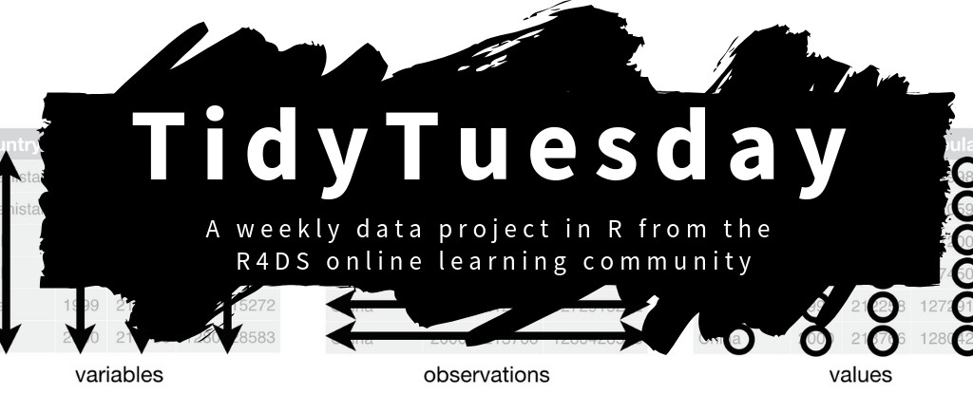


Lesson #1 – Getting involved.. Where to look? (plenty of sources out there!)
https://www.tidytuesday.com
“We are a grassroots journal club initiative that helps young researchers create local Open Science journal clubs at their universities to discuss diverse issues, papers and ideas about improving science, reproducibility and the Open Science movement.”
https://reproducibilitea.org
https://carpentries.org/community/
…etc

Slide 39

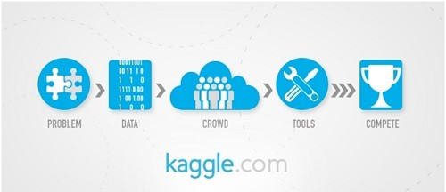


Lesson #1 – Getting involved.. Where to look? (plenty of sources out there!)
Explore exciting projects! ☺
https://towardsdatascience.com
https://www.kaggle.com/rtatman/welcome-to-data-science-in-r/
Publish your Open Source Software projects!
https://joss.theoj.org

Slide 40
Lesson #1 – Recommended readings: a few hand-picked articles
Article Source: Good enough practices in scientific computing
Wilson G, Bryan J, Cranston K, Kitzes J, Nederbragt L, et al. (2017) Good enough practices in scientific computing. PLOS Computational Biology 13(6): e1005510.https://doi.org/10.1371/journal.pcbi.1005510
Article Source: Best Practices for Scientific Computing
Wilson G, Aruliah DA, Brown CT, Chue Hong NP, Davis M, et al. (2014) Best Practices for Scientific
Computing. PLOS Biology 12(1): e1001745.https://doi.org/10.1371/journal.pbio.1001745
Wilkinson, M., Dumontier, M., Aalbersberg, I. et al. The FAIR Guiding Principles for scientific data management and stewardship. Sci Data 3, 160018 (2016). https://doi.org/10.1038/sdata.2016.18
Wickham H. Tidy Data. Journal of Statistical Software 59(10); (2014). 10.18637/jss.v059.i10

Slide 41
Lesson #1 – Picking up the terminology - Glossary / Working definitions
Engine (e.g. R) := R is a system for statistical computation and graphics. It provides, among other things, a programming language (compiling user-inputted commands), high level graphics, interfaces to other languages and debugging facilities.
IDE (e.g. RStudio) := Integrated Development Environment: An integrated development environment is a software application that provides comprehensive facilities to computer programmers for software development.
GUI := Graphical User Interface: A GUI (graphical user interface) is a system of interactive visual components for computer software.
CRAN := The Comprehensive R Archive Network. CRAN is a network of ftp and web servers around the world that store identical, up-to-date, versions of code and documentation for R. Please use the CRAN mirror nearest to you to minimize network load URL: https://cran.r-project.org .
Working directory := In computing, the working directory of a process is a directory of a hierarchical file system, if any, dynamically associated with each process. It is sometimes called the current working directory.

